Slide 1


SolidWorks Workshop
By Engineering Club

Slide 2
What is CAD?
CAD
CAD = Computer Aided Design
Using any CAD program ( like OnShape, SolidWorks, Fusion 360, etc.) you can create 3D objects that are parametric Very useful for engineering!
Paramentic - models are create/defined by parameters, relationships and constraints. (ex. Angles, length, height, other models)
SolidWorks
An industry standard CAD program used by engineers and designers for production ready documentation in product development!

Slide 3
CAD Workflow
Make a 2D-Sketch
Extrude the Sketch
Creates a 3D object
(extrude mean to push out)
Modify the object With features
Once again using extrude and or cut (to remove any of the extruded portions)

Slide 4
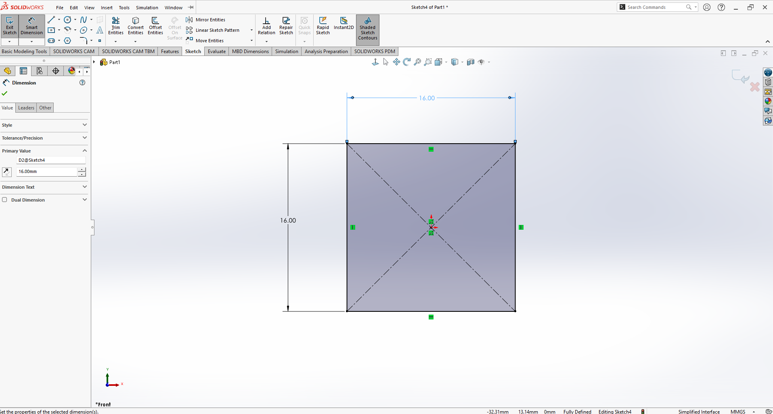
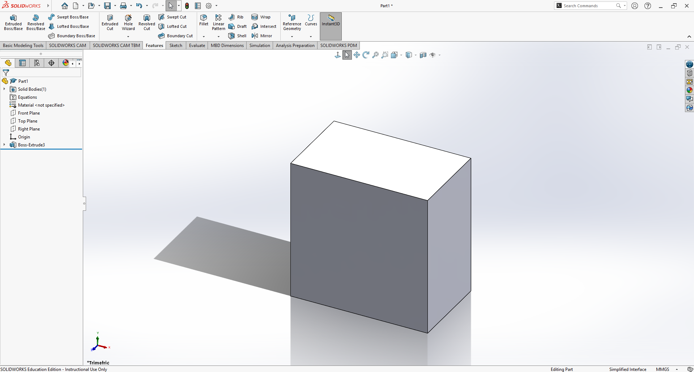

2D Sketch
3D Object
Extrude
sketch
Notes:
The work flow

Slide 5
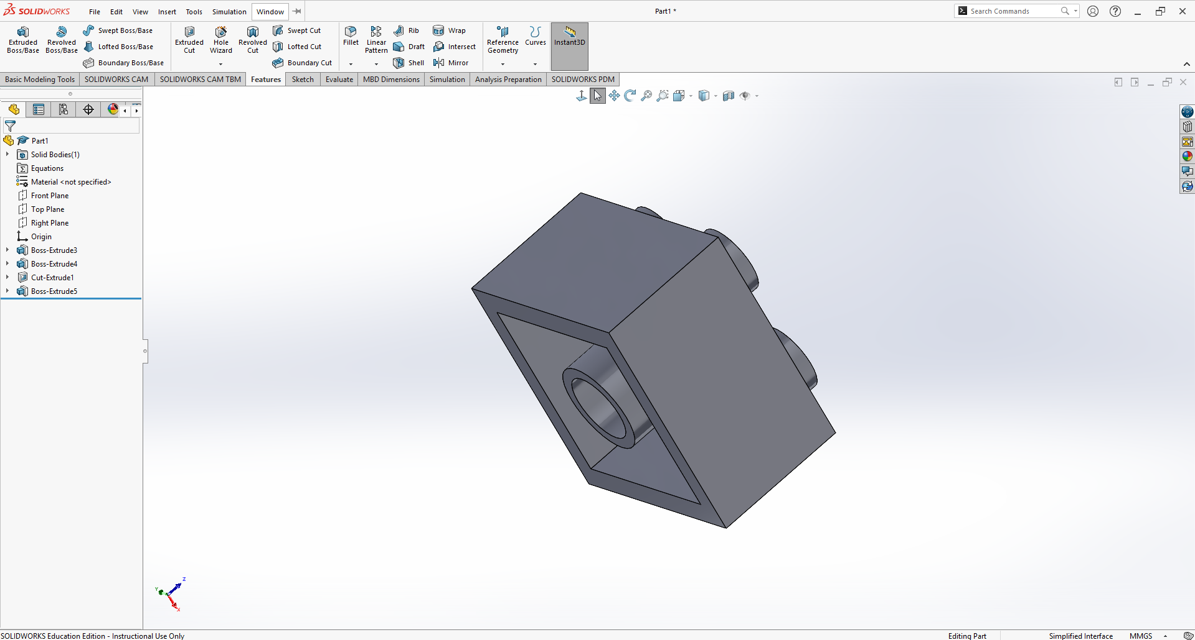
3D Object
3D Object With Features
Add/ Remove Features

Slide 6
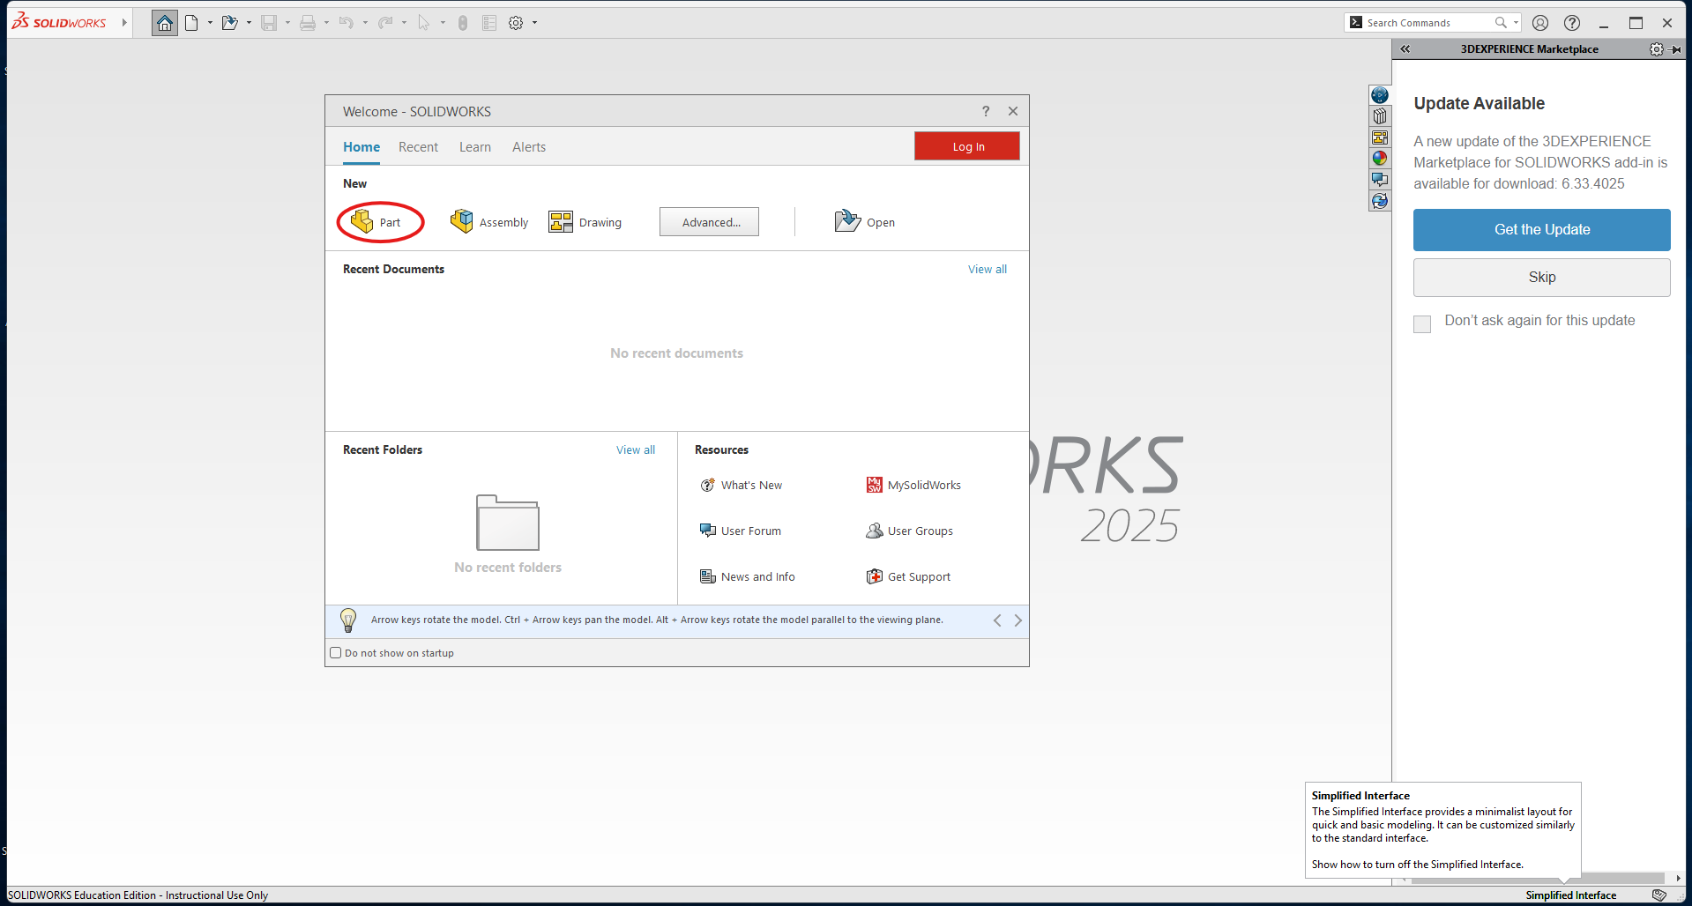
Create a document

Slide 7
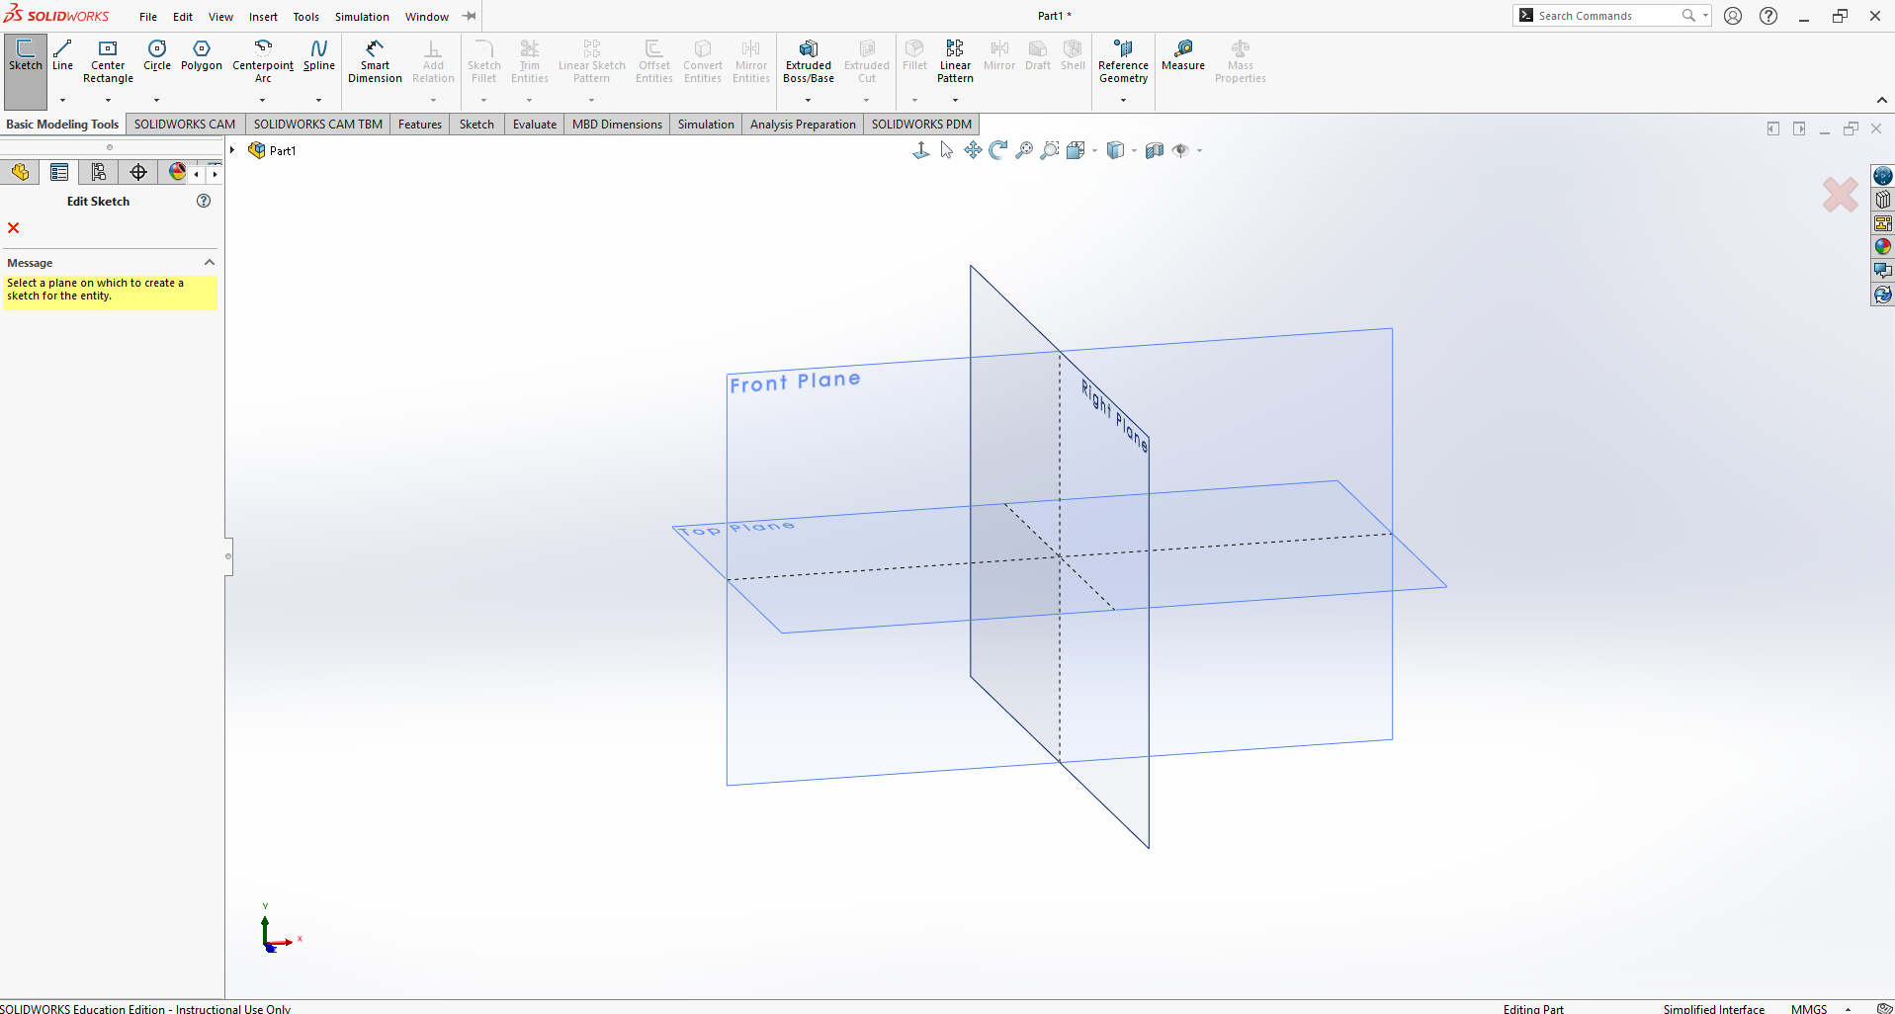
Basic Navigation
You can change your view by using the arrows on your keyboard
You can also change your view using the arrows on the bottom left corner!
Another handy way you can change your view is by using the center clicker of your mouse

Slide 8
Start your first sketch
Click sketch on the top left of the page and select the plane you wish to sketch on
In our case select the “Top Plane”

Slide 9





Basic Tools in Sketch
Under the sketch tab, there are:
Line
Rectangle
Circle
Dimension tool
Constraints (coincident, Parallel, Equal, ect.)
Location:

Slide 10
Create a square with dimensions
Select the “center rectangle” option on the toolbar at the very top; we’ll be drawing from the “center point” of the drawing
Once drawn out, select “smart dimension”
Smart dimension a 16x16 mm square by selecting the sides of the shape

Slide 11
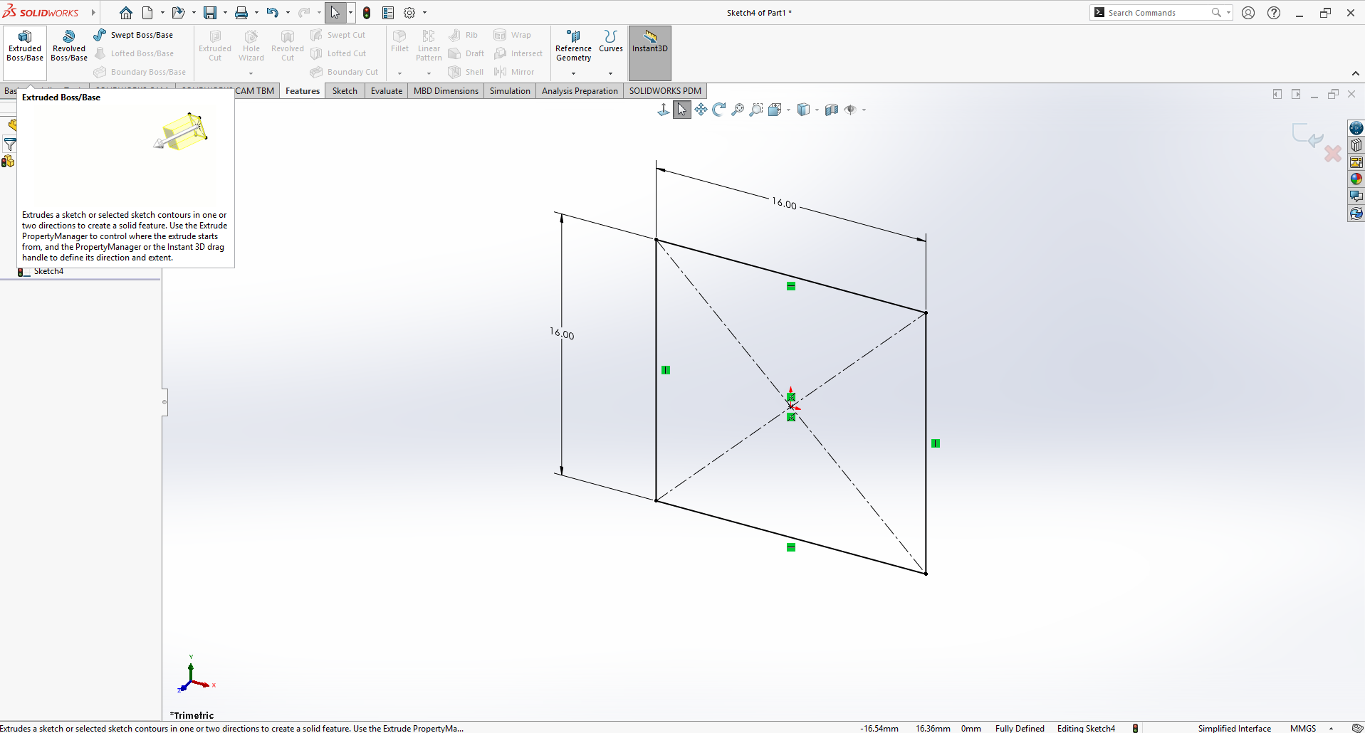

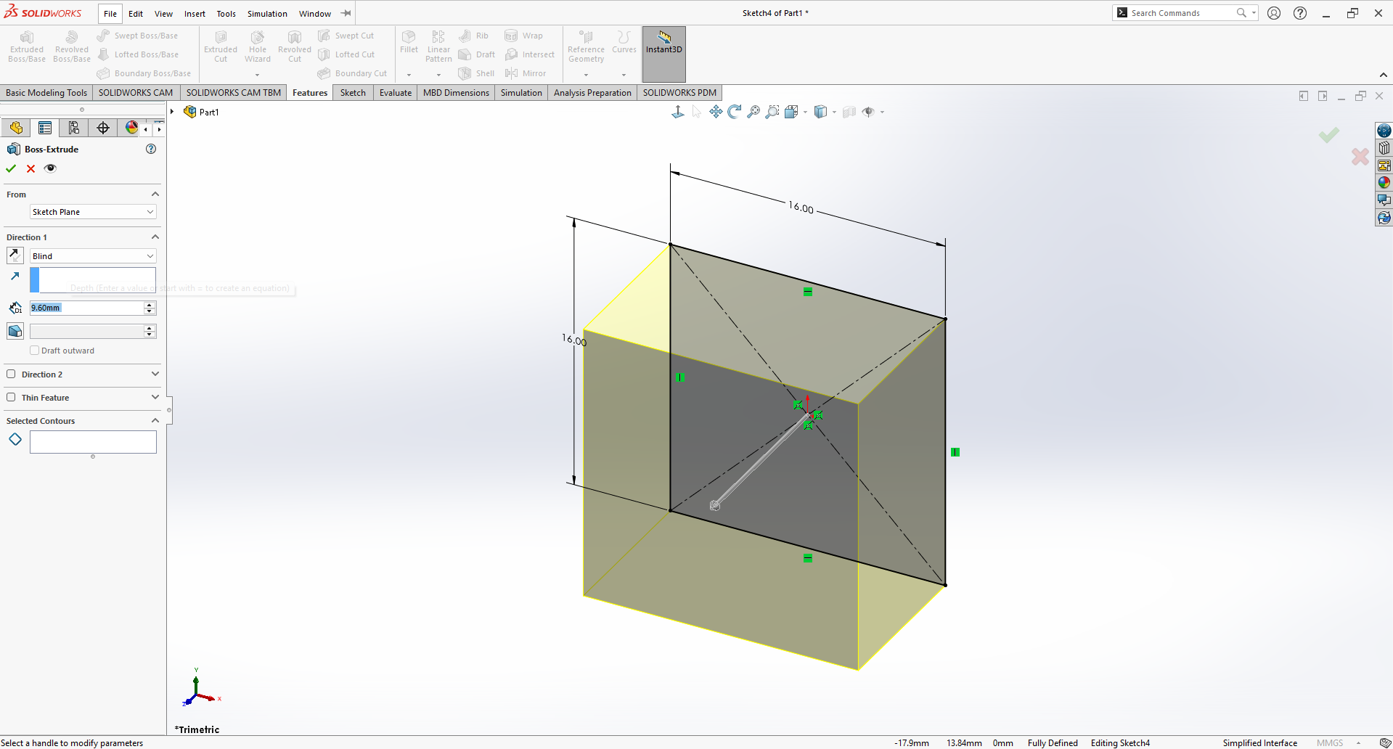
Now We Extrude
Extrude
Select the “Extrude Boss/Base” button in the features tab, then click on the sketch we created
Set the depth of the extrusion to 9.6 mm

Slide 12
Congrats! You have a Cube!

Slide 13
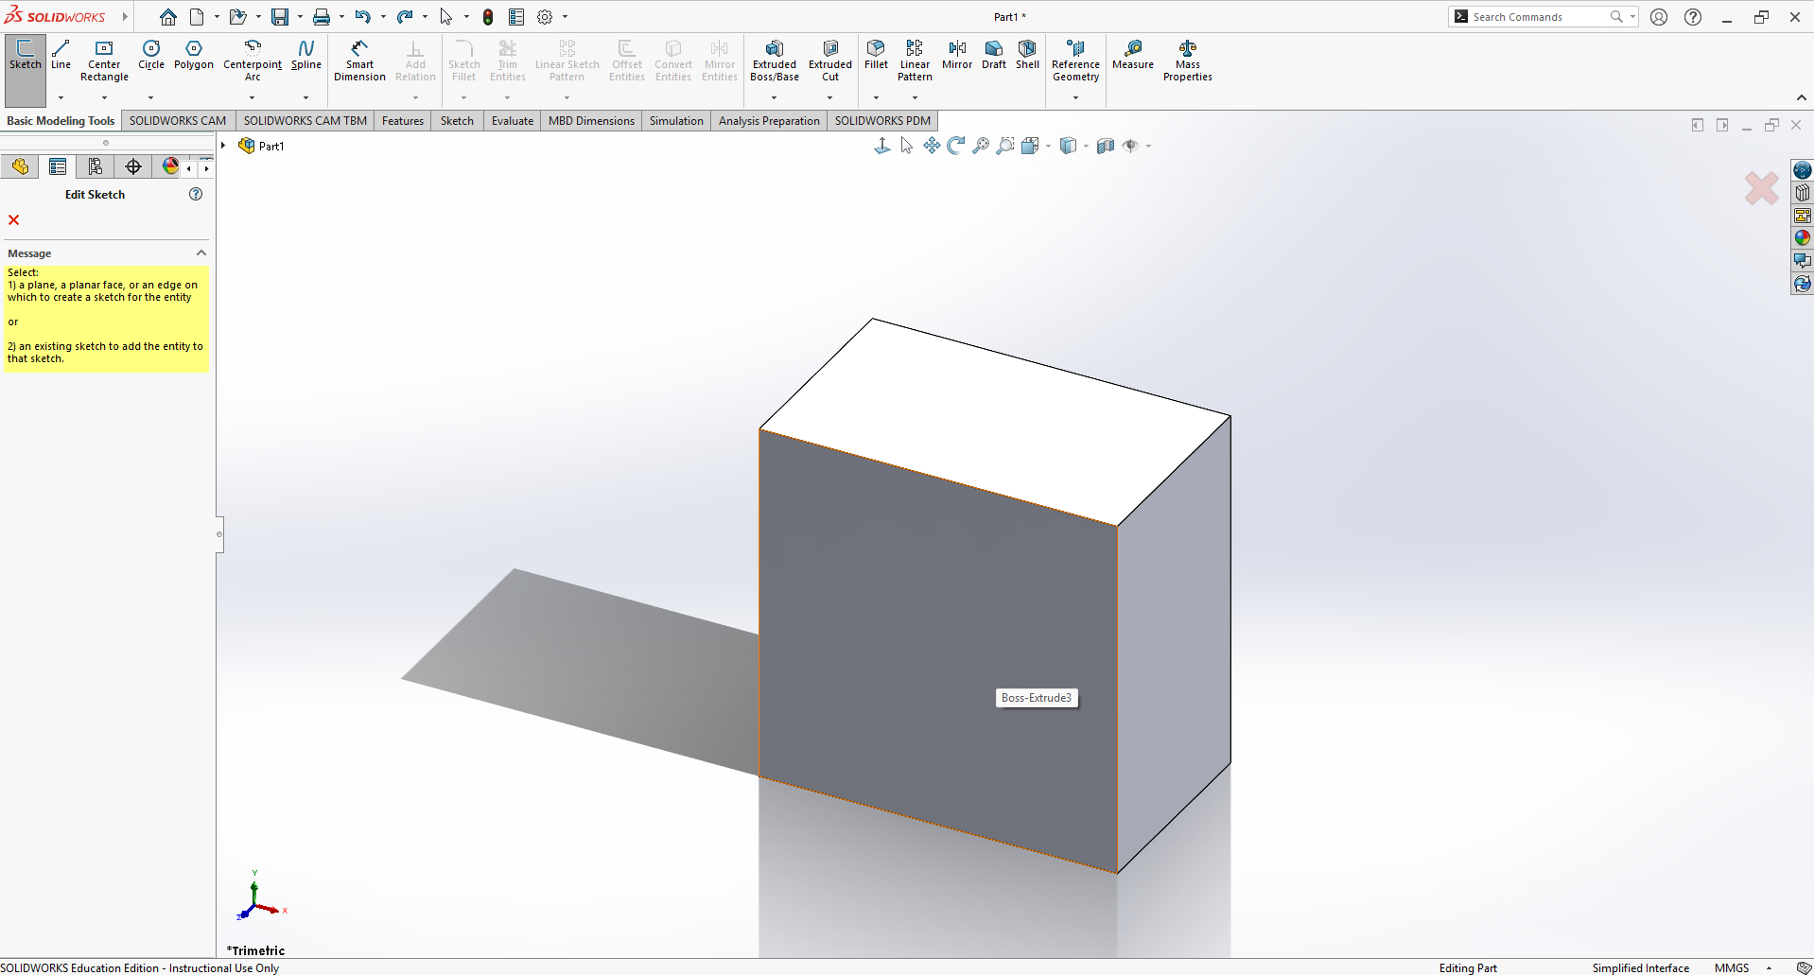
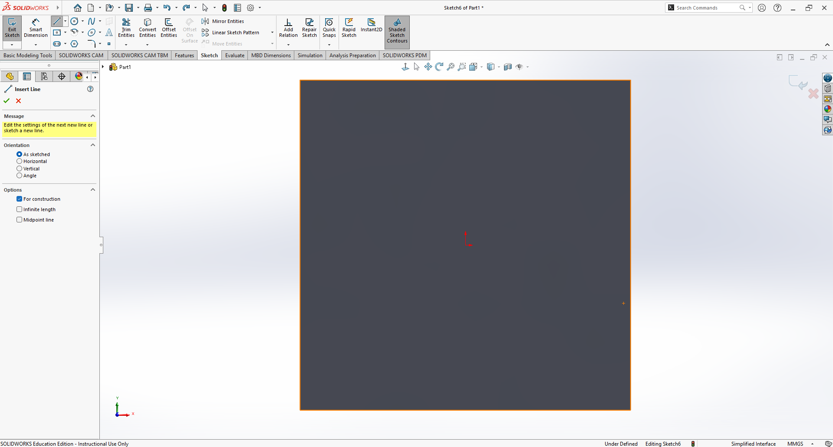
Add a feature
We want to make multiple extrusions in our cube.
To do this we sketch on top of the face of the cube!
Select the sketch button and select the top plane of the cube!

Slide 14
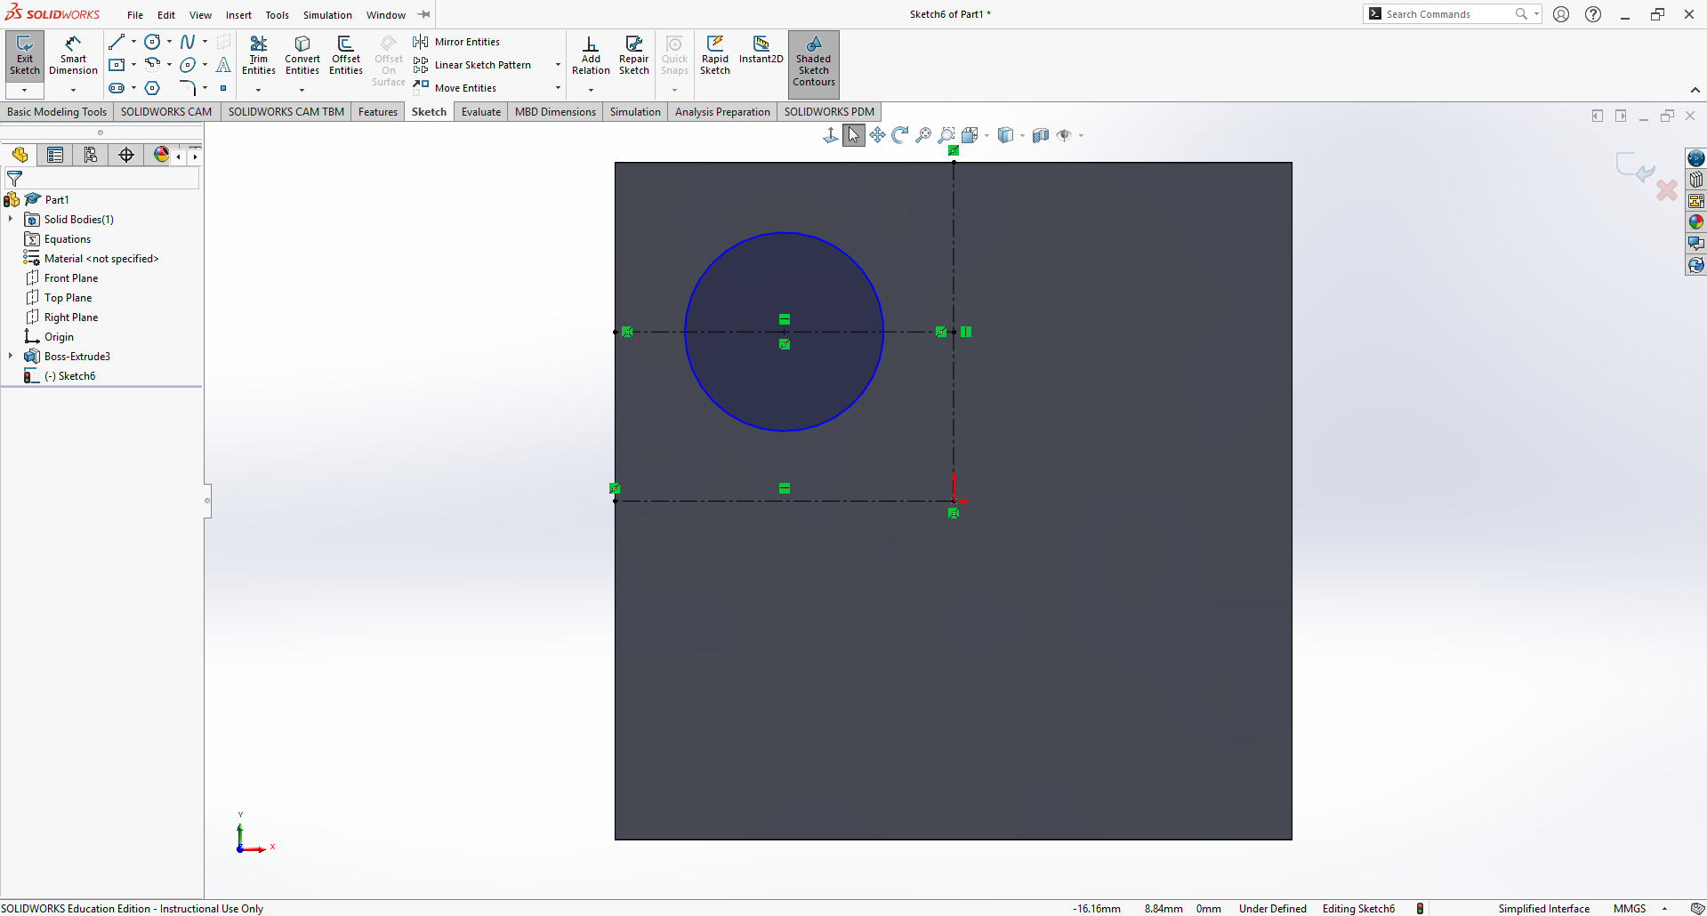
Add a feature cont’d
Now select the line button!
We’ll be making “construction” lines to show the center point of one corner of the square
Next, select the “center circle” button in sketch to create a circle.
Click on the center point created from the construction lines
Dimension with a diameter of 4.8mm
Now we’ll create a circular sketch pattern! (this is done to create copies of a shape on a plane with even spacing)

Slide 15
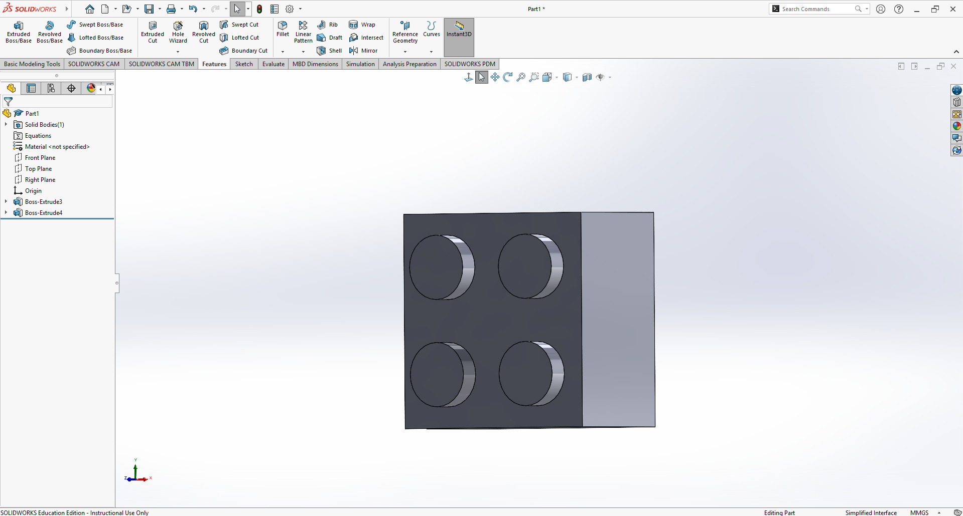
Add Material
Let’s start extruding!
Select the “Extruded Boss/ Base” option in the features tab and select your circle
You’ll notice that all circles will extrude, nice!
Extrude to a height of 1.6 mm
Awesome! It’s starting to look like a Lego!

Slide 16
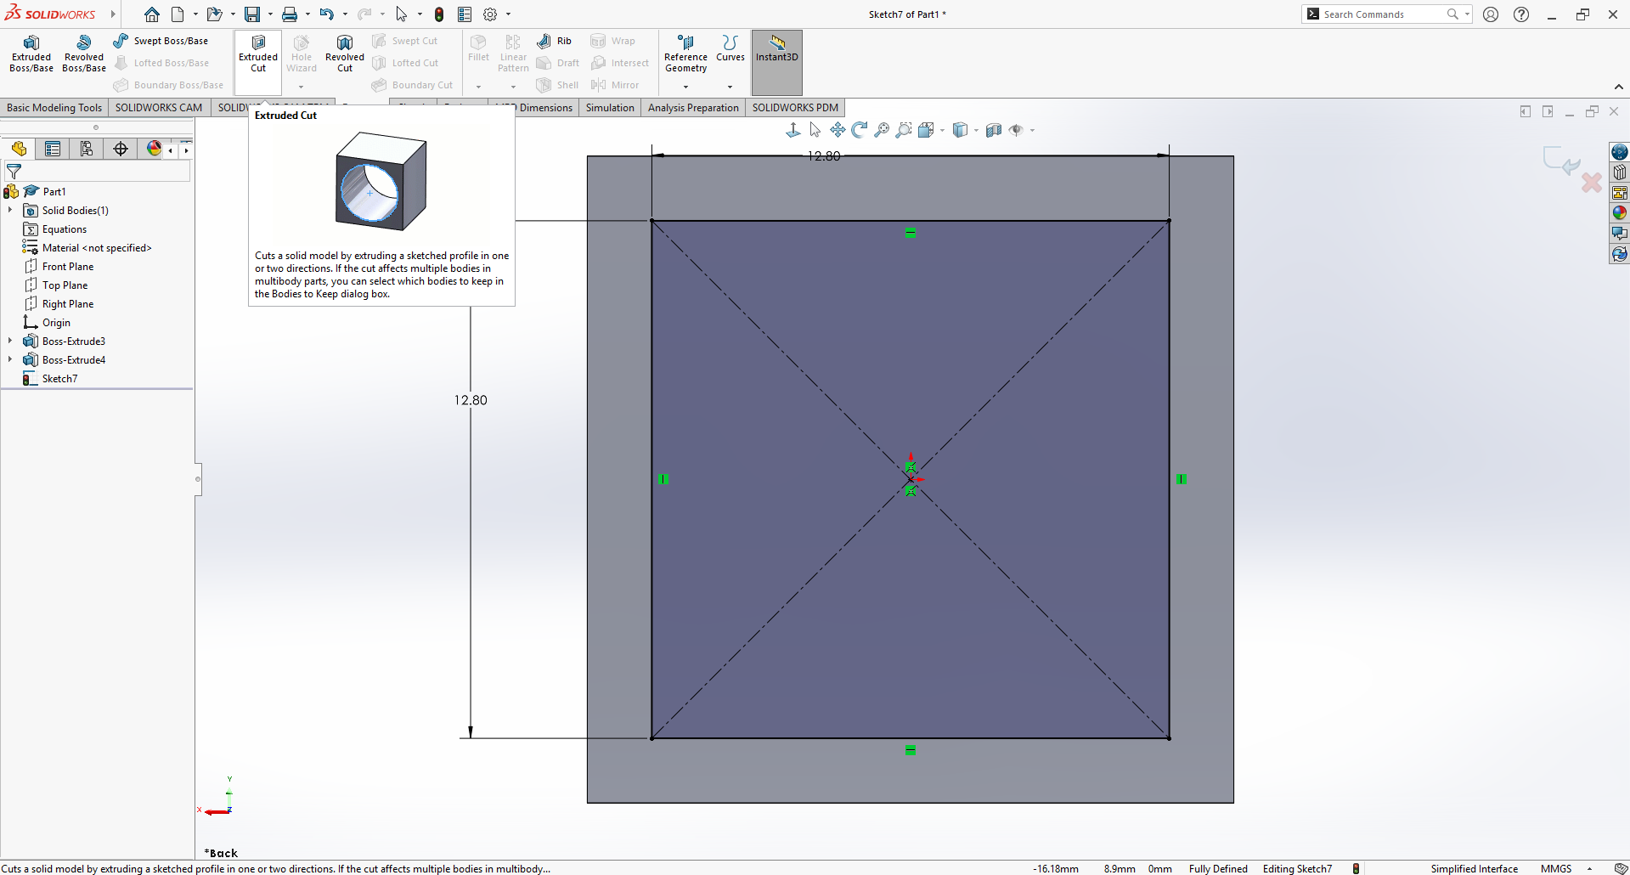
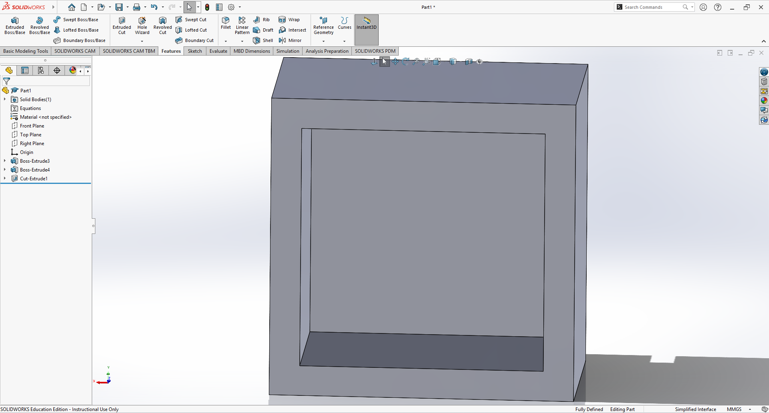
Remove Material
Now we cut the bottom portion of the block.
Start by sketching another square, opposite of the side of the extrusions we made
Let’s space this inner-square 1.6 mm apart from the outer-square
This time we select “extruded cut” on the shape
We’ll be cutting 8 mm from the smaller square
Click the check mark when done.

Slide 17
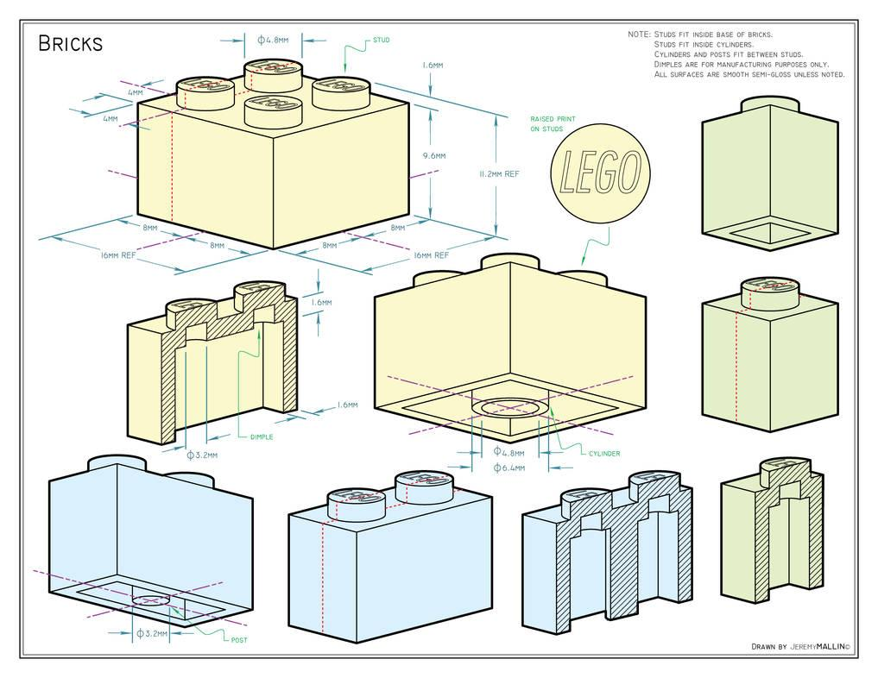
Try out the last part!
Try making the center circle on the bottom of the brick!

Slide 18
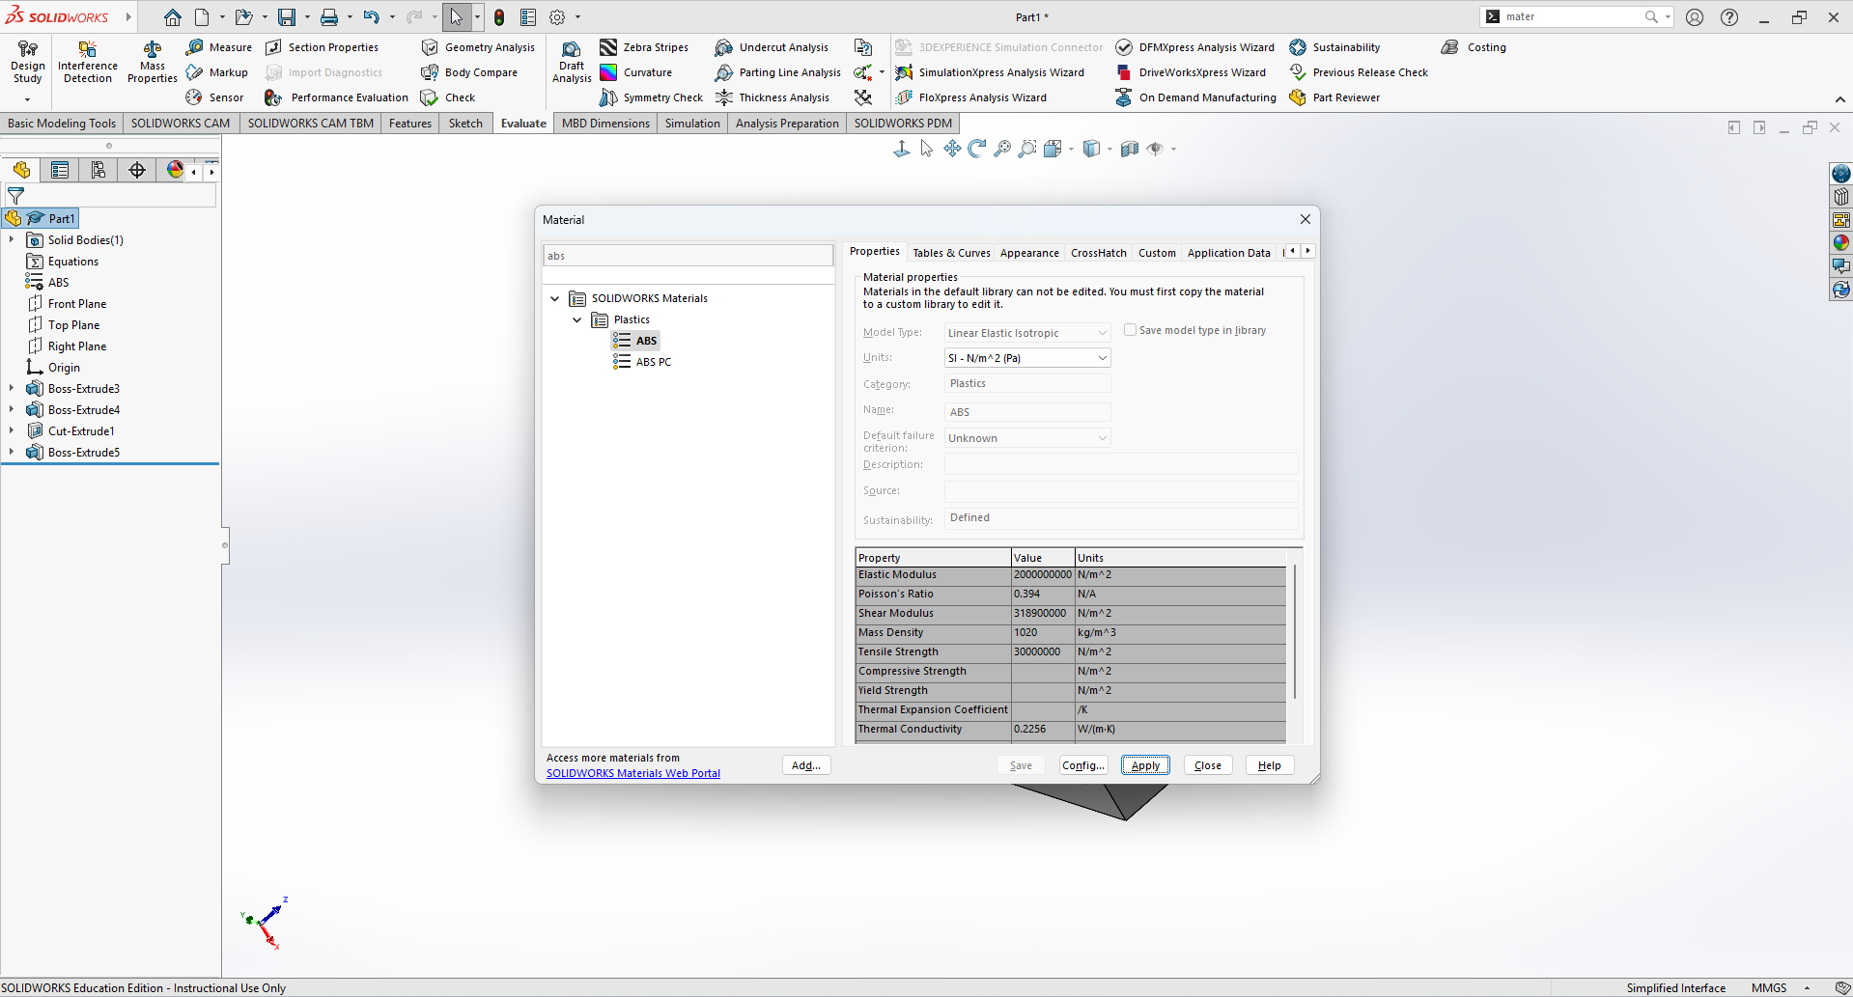
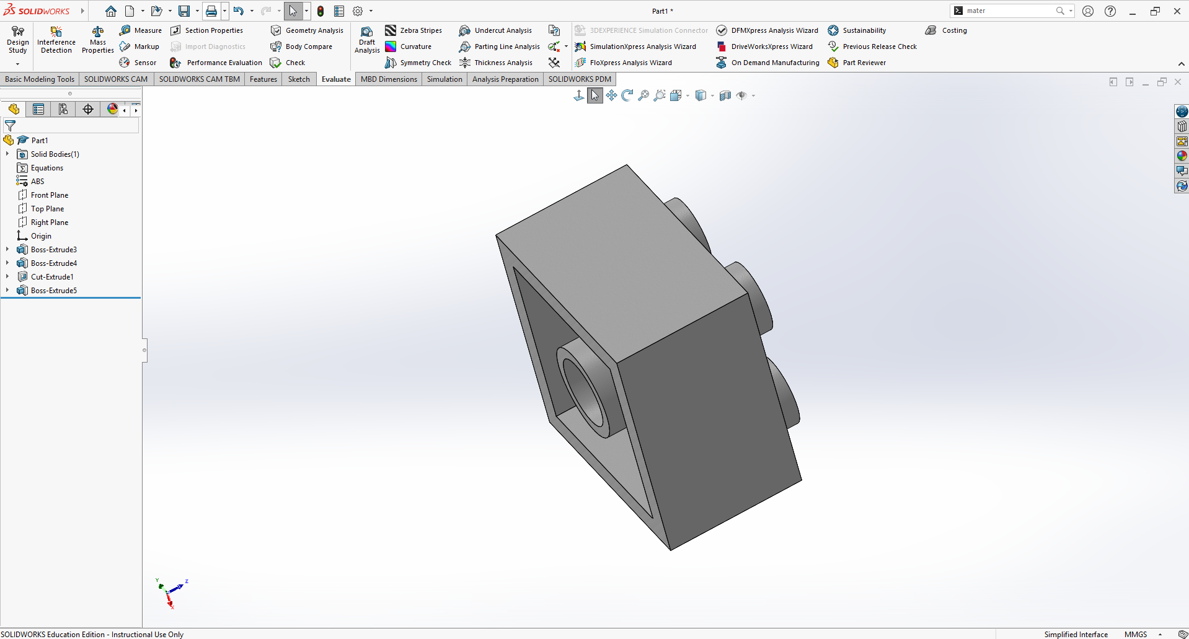
Material, who?

Slide 19
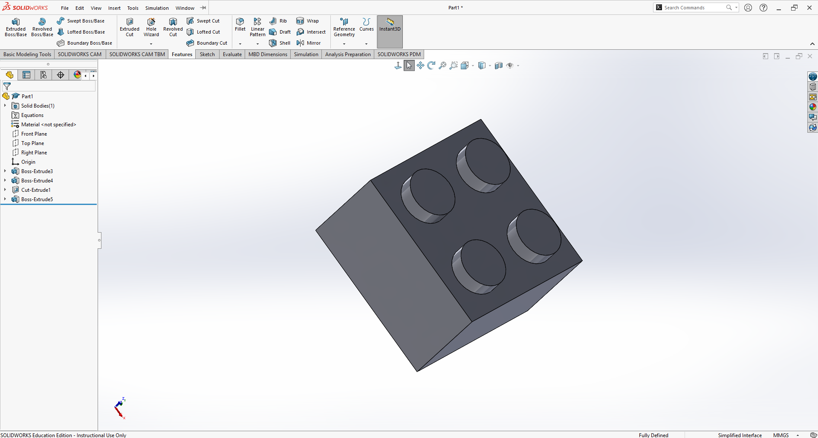
Congrats! You made a 2x2 Lego brick!

